Slide 1
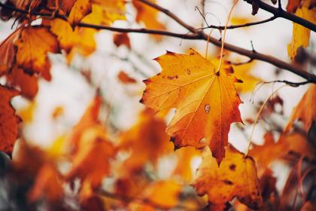
Harvest
Louise Darcy
The Family Album
1977

Slide 2
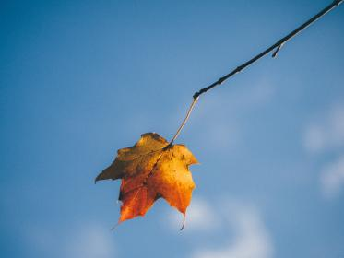
What do I hold of the harvest of the past?

Slide 3
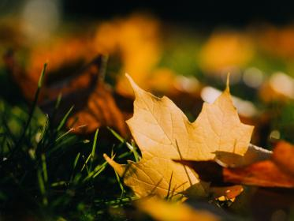
The orange moon at Hallowe’en
As children’s feet scuffed through dried leaves

Slide 4
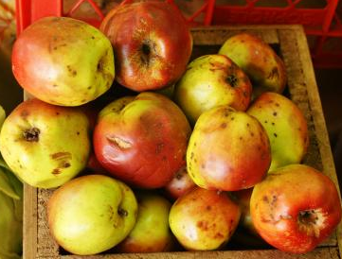
An orchard view of apples everywhere
On bending boughs, red, yellow, streaked,
A mellow afternoon of ripened fruit

Slide 5
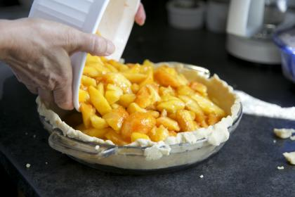
Thanksgiving dinner served by a great-grandmother
Who made nine decades seem a natural thing.

Slide 6
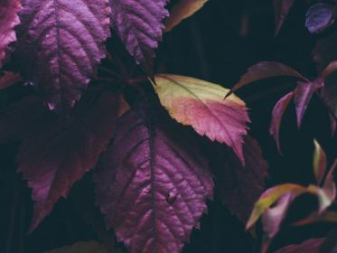
What do I hold of harvest now
To add to all the hours of purple haze
That I have kept in memory?

Slide 7
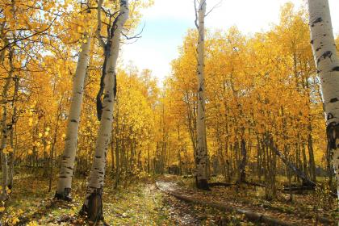
I add this day of maple flame and air
That brings the mountains nearer to the sea,
Vivid statement of autumn splendor.

